Slide 1

EPSILON PRODUCTIONS
Music Analysis

Slide 2



About us
Epsilon Productions is a global music company that is planning to record and launch new singles next year.
To ensure the success of our artists we did the following market analysis of the listened and produced music in the countries where we have presence.
Relate the above characteristics with the lattitude of the country
Analyzed songs by valence, energy and danceability
Segmentation of music by gender.
Evaluated the most popular songs through time
Used Spotify and Billboard datasets.

Slide 3
Studied variables
Valence
A measure from 0.0 to 1.0 describing the musical positiveness conveyed by a track. Tracks with high valence sound more positive while tracks with low valence sound more negative.
Energy
Is a measure from 0.0 to 1.0 and represents a perceptual measure of intensity and activity. Typically, energetic tracks feel fast, loud, and noisy.
Danceability
Describes how suitable a track is for dancing based on a combination of musical elements. A value of 0.0 is least danceable and 1.0 is most danceable.

Slide 4
Time analysis
Valence

Slide 5
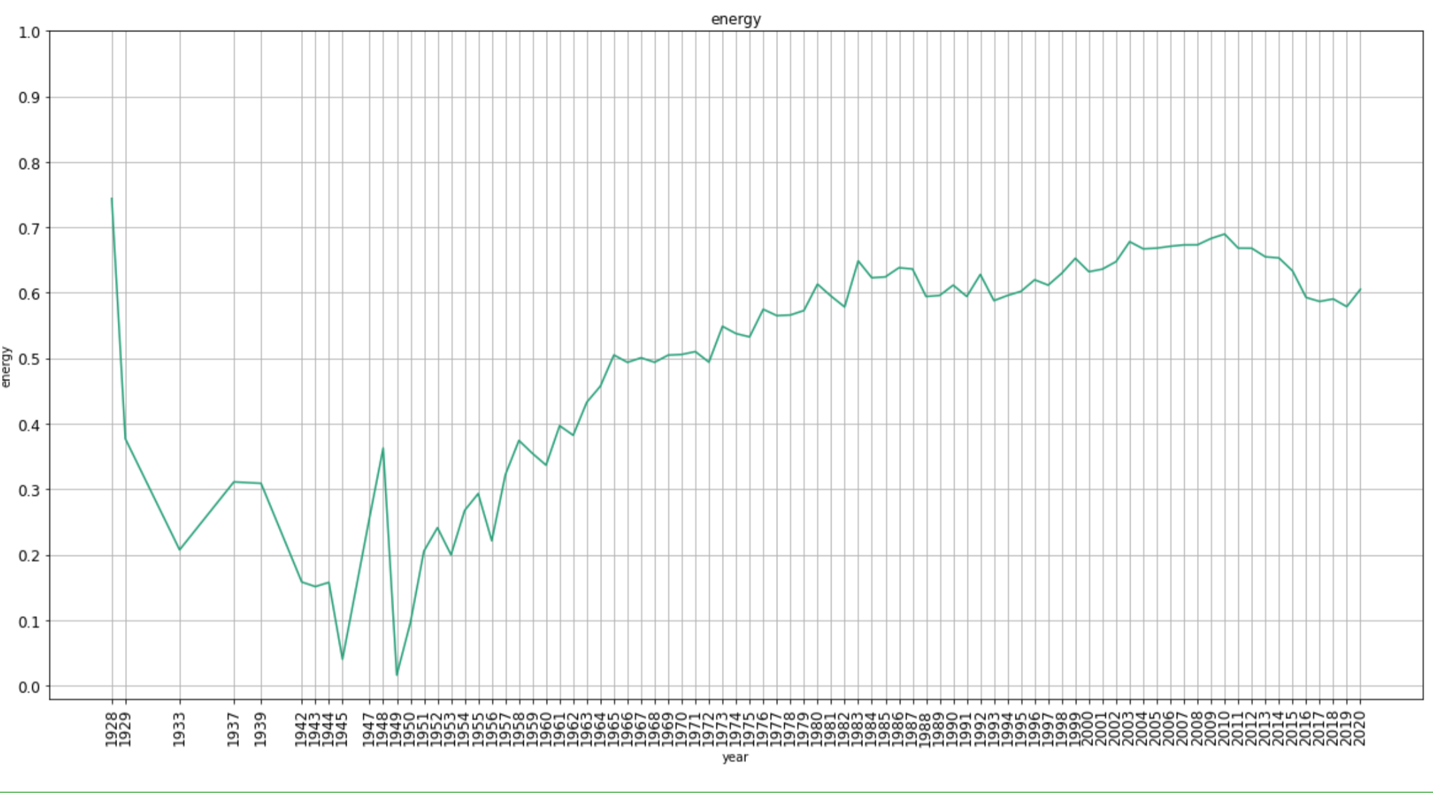
Time analysis
Energy

Slide 6
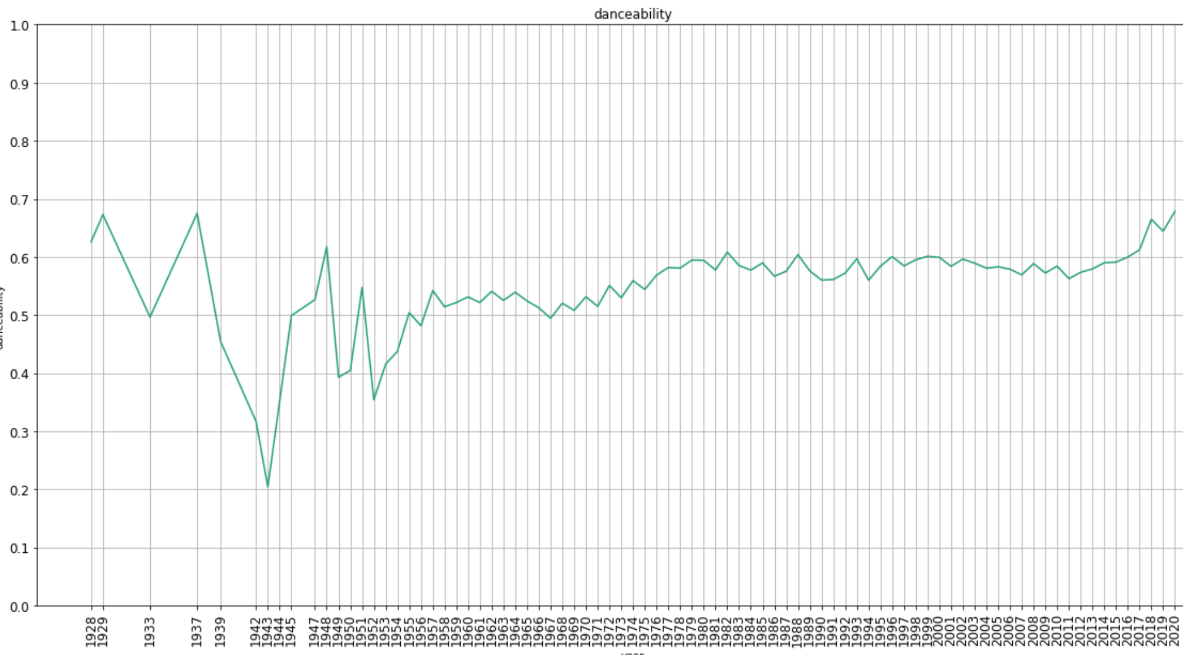
Time analysis
Danceability

Slide 7
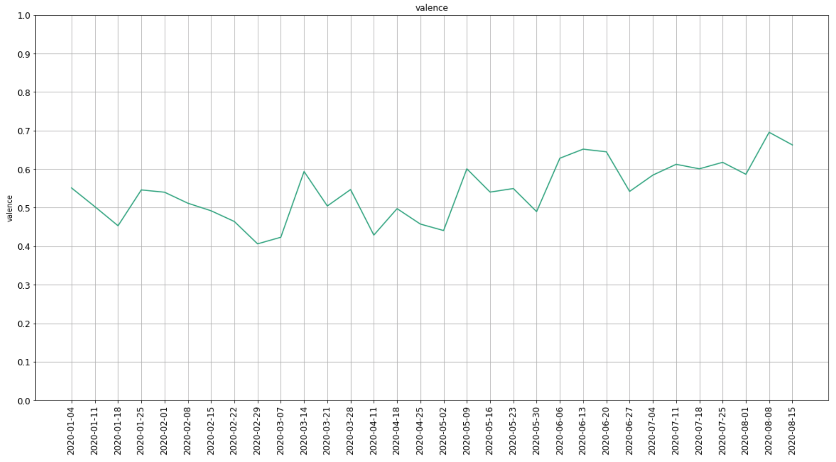
Actual - 2020
Valence

Slide 8
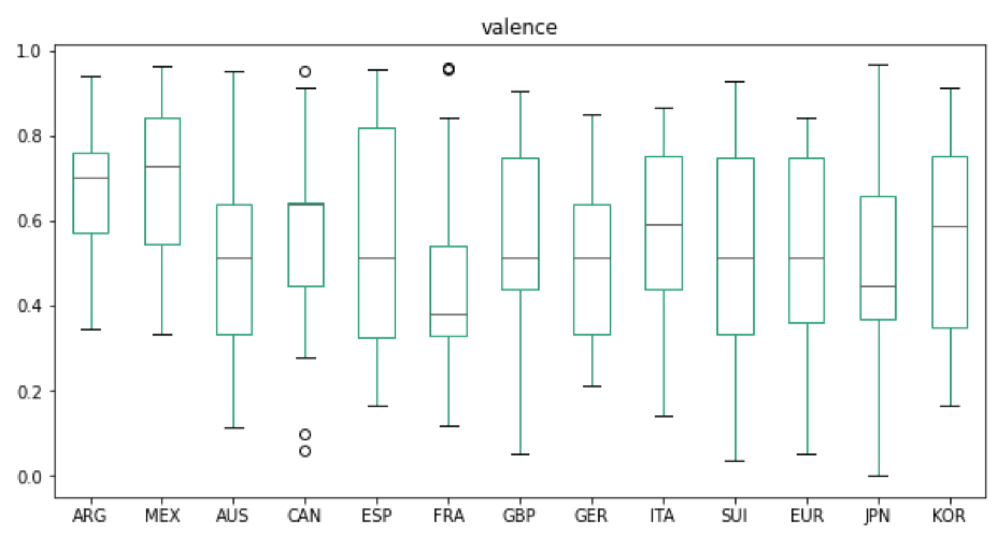
Country analysis
Valence

Slide 9
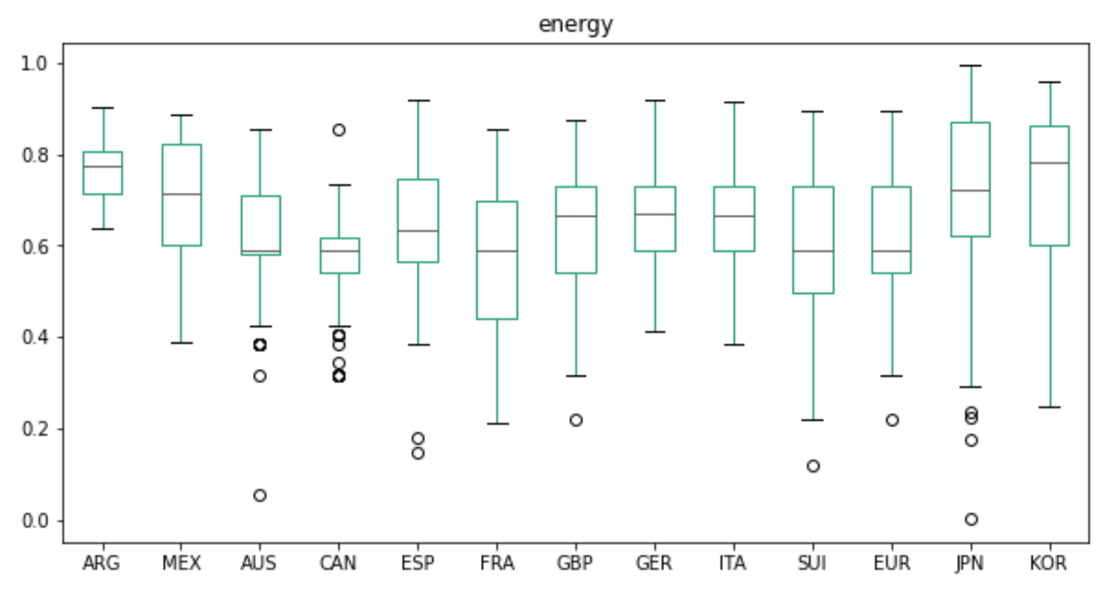
Country analysis
Energy

Slide 10
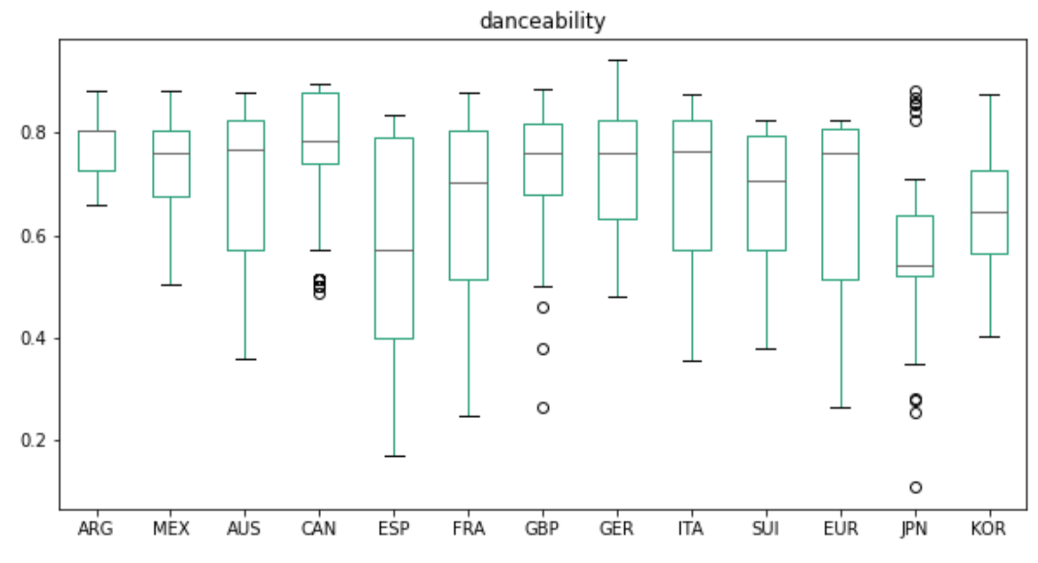
Country analysis
Danceability

Slide 11
Popularity
Valence
energy
Danceability

Slide 12
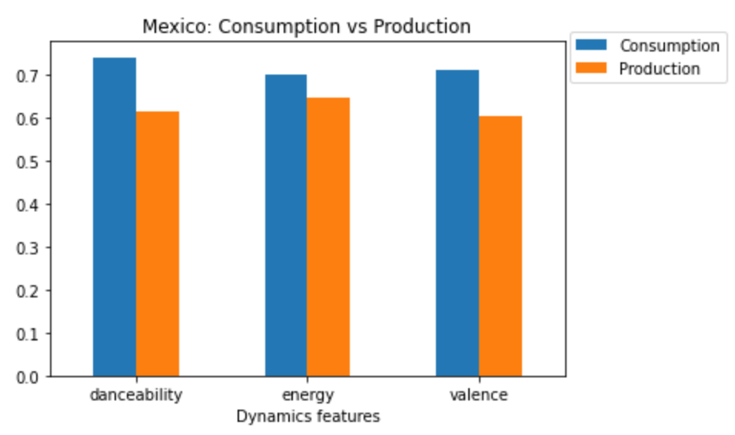
Consumption VS Production

Slide 13
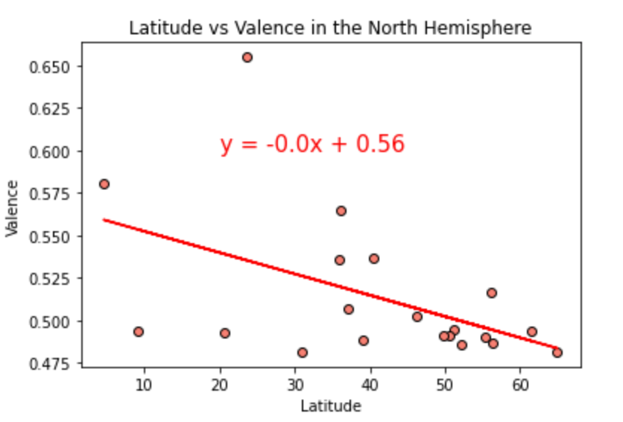
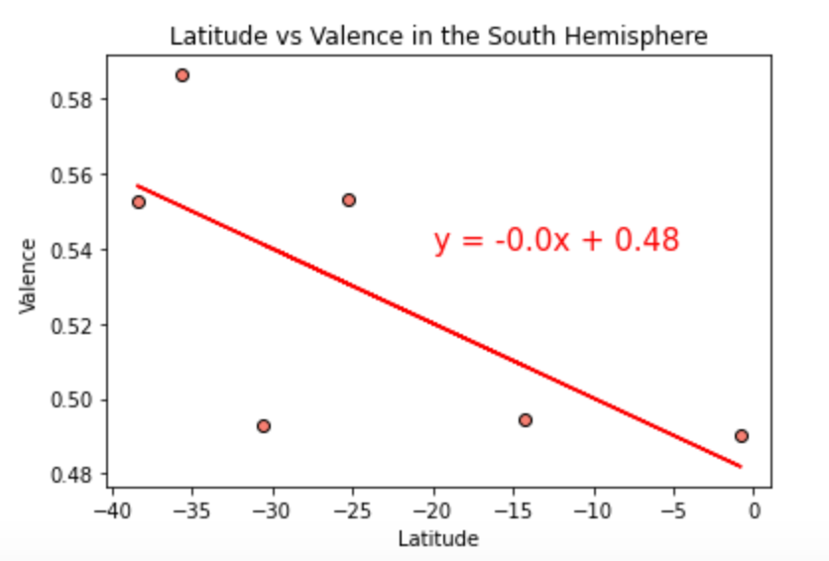
Latitude - Valence
North hemisphere
South hemisphere

Slide 14
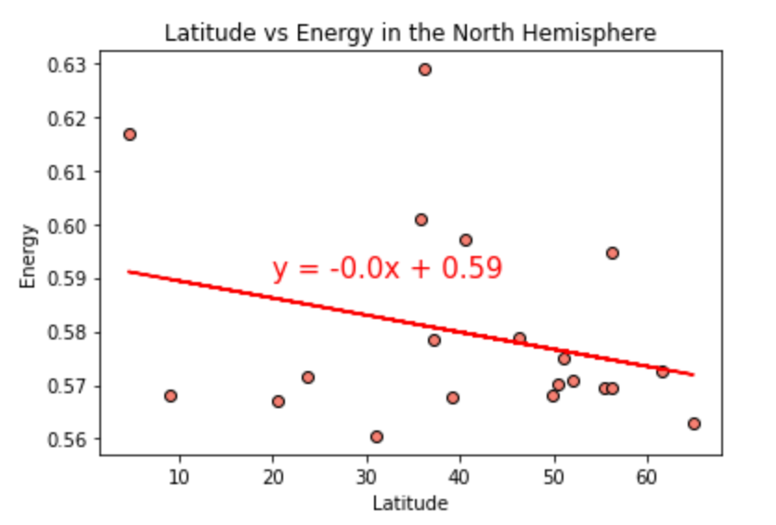
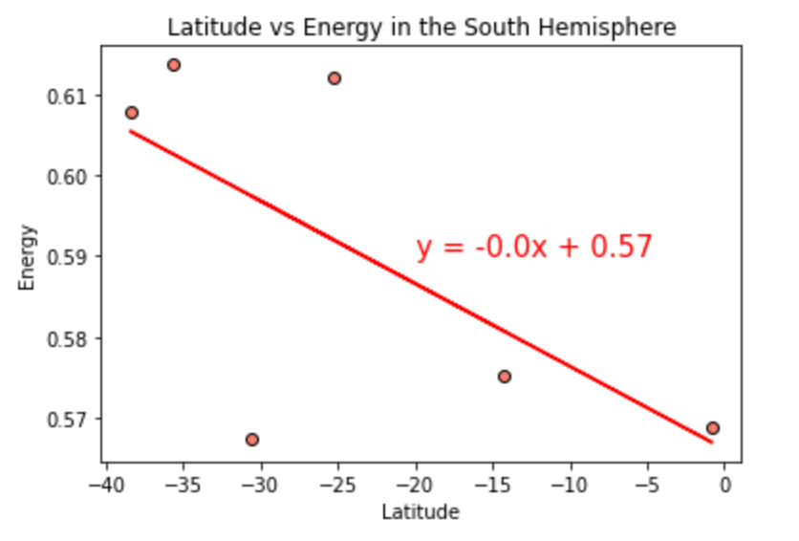
Latitude - Energy
North hemisphere
South hemisphere

Slide 15
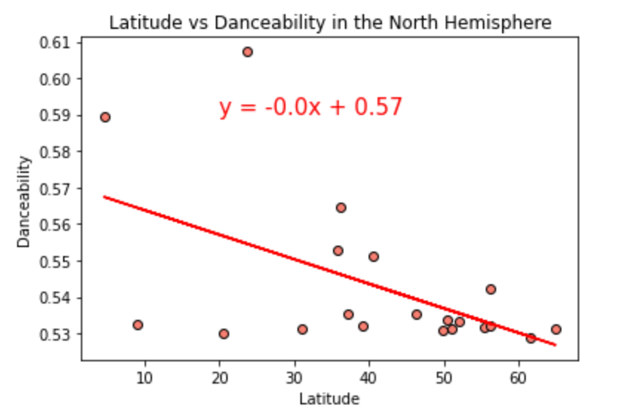
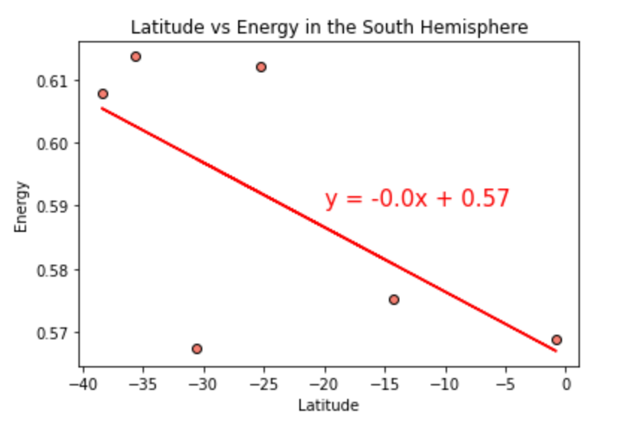
Latitude - Danceability
North hemisphere
South hemisphere

Slide 16
Map – Valence

Slide 17
Conclusions
Events through history have an influence on music type people listens
Genre does not determine the valence, nor the energy or danceability values.
We observed that each country have different values for valence, energy and danceability for their popular songs.
Consumed music does not have the same attributes as the Produced one, matching these values will result on the success of the launched songs.

